Slide 1
How Worksites Can Improve Community Health
Working Well Conference
Elizabeth Ablah, PhD, MPH
April 11, 2023

Slide 2
Intent of the Initiative
Make the healthy behavior easy

Slide 3
The Problem(s)

Slide 4
3 Four 80
3
Four
80
Risk Factors
Physical Inactivity
Poor Nutrition
Tobacco Use
Chronic Diseases
Heart Disease
Type 2 Diabetes
Lung Disease
Some Cancers
80% of premature deaths in the United States

Slide 5
Physical Inactivity
3.2 million deaths worldwide can be attributed to inactivity each year (WHO, 2023)
Inactivity contributes to 1 in 10 premature deaths in the
U.S. (CDC, 2020)
Approximately 110,000 deaths per year could be prevented if US adults (40 to 85 years) increased moderate activity by 10 minutes per day (Saint-Maurice et al., 2022)

Slide 6
Poor Nutrition
11 million deaths worldwide can be attributed to a poor diet (Afshin et al., 2019)
Unhealthy diet contributes to more than 500,000 deaths each year in the U.S. (Mokdad et al., 2018)

Slide 7
Tobacco Use
Tobacco use kills 8 million people each year, including 1.2 million from exposure to second-hand smoke (WHO, 2022)
Tobacco kills up to half of all users (WHO, 2022)
For each person who dies from smoking-related disease, there are 30 more who have at least one serious illness (CDC, 2020)
Tobacco causes cancer, heart disease, stroke, and lung diseases (CDC, 2020)

Slide 8
Stress
64% of Americans: work is main source of stress (APA, 2019)
In 2020, 70% said work was a significant source of stress
Approximately 30% of workers say their stress level is “high” or “unsustainably high” (Wrike, 2019)

Slide 9
The Annual Health Care Costs
Physical Inactivity
Tobacco Use
Inadequate levels of physical activity are associated with $117 billion. (CDC, 2022)
Cigarette smoking cost more than $240 billion (plus $185 billion in productivity). (CDC, 2022)
Poor Nutrition
Stress
Poor diets are linked to $50 billion. (Jardim et al., 2019)
Stressed workers were 15% more costly than their non-stressed counterparts after one year and 46% more costly after three years. (Goetzel et al., 2020)

Slide 10
The U.S. Health Disadvantage
The prevalence of poor health conditions in the United States is higher than other wealthy countries.
U.S. workers have less access to, and pay more for, healthcare than workers in other wealthy countries.
This increases costs for businesses, lowers productivity and competitiveness, and compromises business success and growth.
(U.S. Department of Health and Human Services, Office of Surgeon General, 2021)

Slide 11
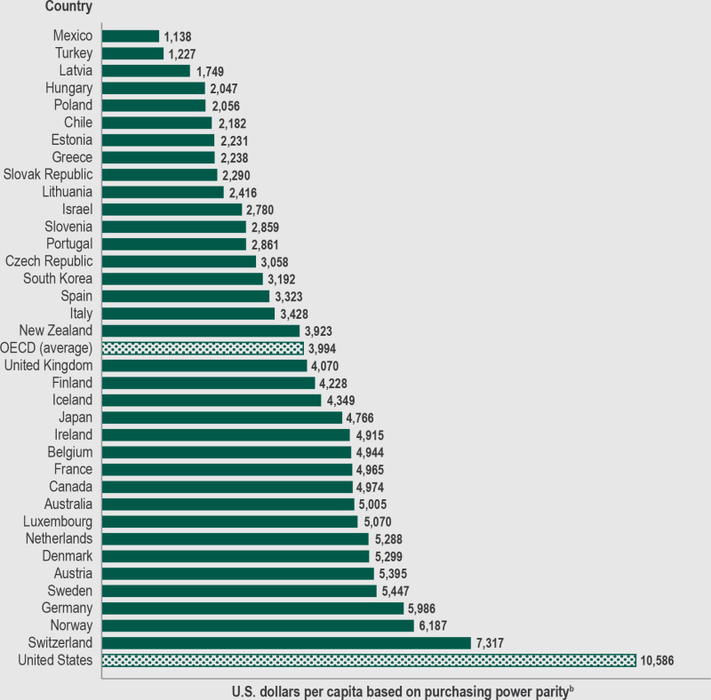
Health expenditure per capita, 2018 (or nearest year) by country and the Organization for Economic
Cooperation and Development average

Slide 12
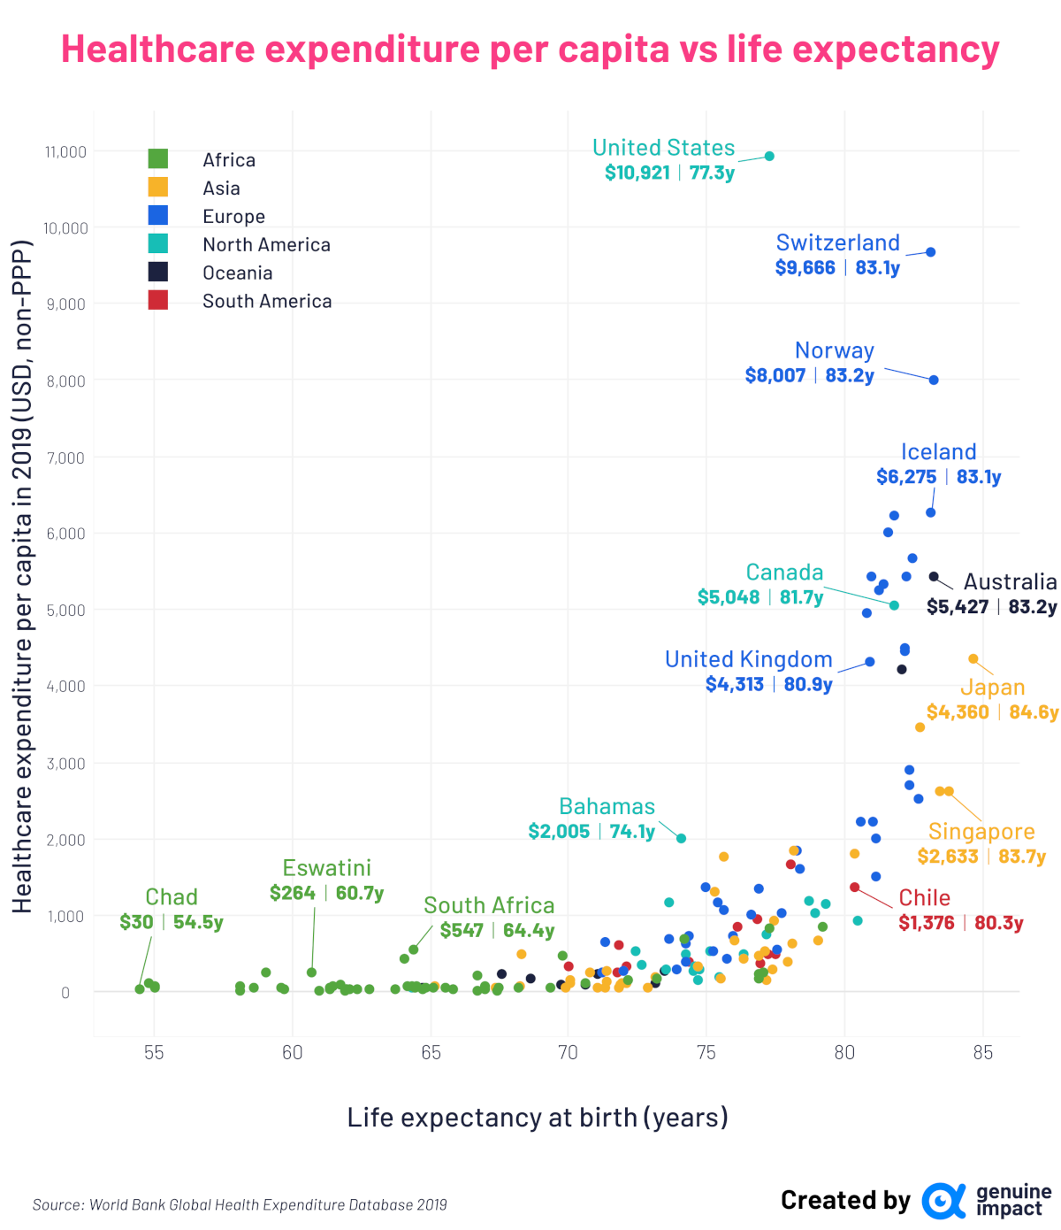
Health Spending & Life Expectancy
Countries that prioritize spending on social services over spending on healthcare have populations with higher life expectancy.
Lower spending on social services contributes to the U.S. health disadvantage.
Between 1962 and 2017, the share of federal spending on social and economic investments (e.g. education) decreased by 59%.
States that dedicate a large proportion of their budgets to social services have greater life expectancies.

Slide 13
Is this about choice?

Slide 14
Physical Inactivity
Increased mechanization at work: 264% increase in low-activity occupations (from 1950 to 2000) (Brownson, Boehmer, Luke, 2005)
Poor access to public transportation
Sidewalks?
Protected bike lanes? Complete Street design?
Safety!

Slide 15
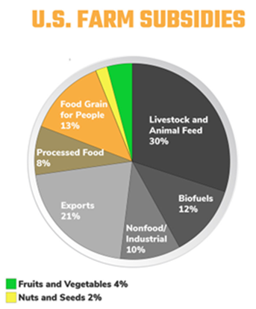
Poor Nutrition
Subsidies
Production. If American adults increased fruit and vegetable consumption to recommended levels, there would not be enough for us to eat!
Access. As supermarket distance increases, fruit and vegetable consumption decreases (Michimi, Wimberly, 2010)

Slide 16
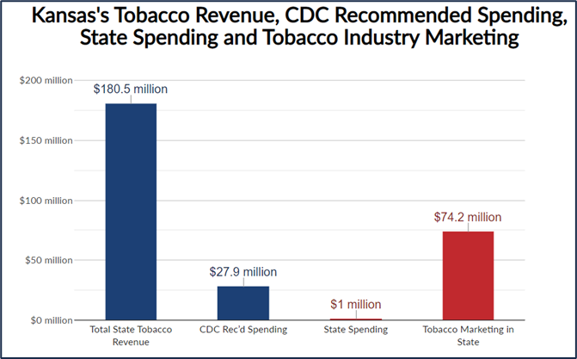
Tobacco Use
Nicotine is addictive. A current smoker tries to quit on average 30 times or more before successfully quitting for one year or longer. (Chaiton et al., 2016)
Appeal of e-cigarettes. Marketed as quit aids. Taste and smell better than cigarettes. Less expensive and not regulated. (Glasser et al., 2017)
Spending - marketing vs prevention

Slide 18
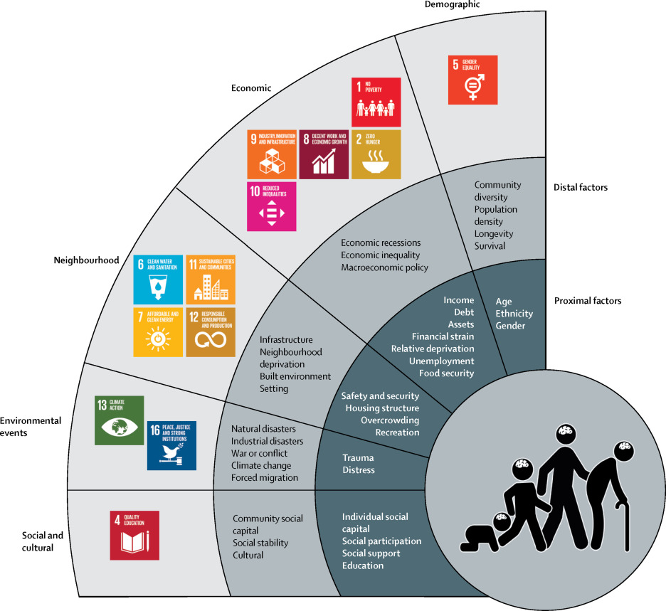
Well-Being
Social Determinants of Mental Disorders
Access to care
89.3 million Americans live in a Mental Health Professional Shortage Area
Significant mental and behavioral health provider shortages
Lund et al., 2018

Slide 19
Why Worksite Wellness?

Slide 20
Benefits of Comprehensive Worksite Wellness
Decreased healthcare costs
Reduced absenteeism
26% reduction in health costs
27% reduction in sick leave and absenteeism
Increased productivity
Improved staff retention
Improved morale
Employees gain 10.3 hours in additional productive time annually
58% of millennials and 54% of Gen Z report that wellness is essential when looking for a job
67% of employees like their jobs when working for companies offering wellness

Slide 21
Why Community Health?

Slide 22
Worksites Benefit When the Community is Healthy
Decreased healthcare costs
Recruit and retain talent
Specific community-strengthening strategies substantially reduce recruitment costs and increase retention rates
Healthier communities have lower rates of disease
Increased productivity
Greater profits
Brand recognition, loyal customers
Workers who live in healthier communities are more likely to arrive at work on time and have fewer unplanned absences
Companies with a stated purpose, generous compensation, and quality customer service that invest in their communities and minimize their impact on the environment outperform less values-focused companies by a factor of 10
66% of adults are willing to pay more for products and services from companies committed to positive social and environmental action
Notes:
(Annual health care costs to employers for employees with diabetes are more than $4,000 higher than for employees without diabetes)

Slide 23
Take Action at the Worksite

Slide 25
How Do We Change?
Social-Ecological Model
Public Policy (state, national)
Community (norms, built environment)
Organizational (workplace, school)
Interpersonal (family, friends, social network)
Individual (knowledge, skills, attitude)
Behavior is complex.
Behavior change is even more complex!
Knowledge is insufficient to prompt behavior change!

Slide 27
Information

Slide 28
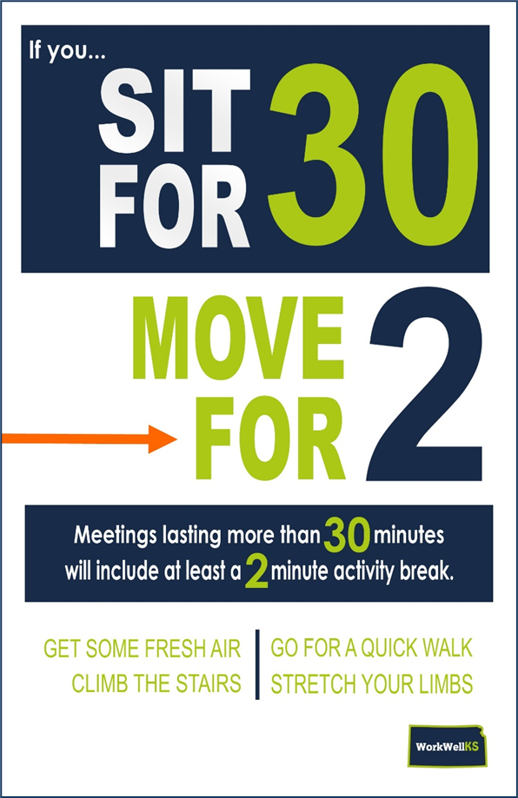
Physical Activity
Information that encourages physical activity (Audrey et al., 2015; Blake et al., 2017; Gazmararian et al., 2013)
Promote worksite activities (e.g. exercise class) or other local opportunities to be physically active
Computer prompts encouraging employees to stand and move (Shrestha, & Bhaumik, 2015)
Establish Campaigns that Promote Physical Activity
Stand Up and Sit Less (Stephen et al., 2014)
Yuma on the Move (University of Arizona)
Active Omaha (Huberty, Dogdge, Peterson, Balluff, 2012)
Stretching aids in the break room (Heinen, Darling, 2009)

Slide 29
Food and Beverage
Dietician to provide nutrition information
Tailored nutrition education
Make employees aware of offerings (programs, incentives, benefit design) for those wanting to opt-in
Establish campaigns that promote tasty (healthy) foods/beverages

Slide 30
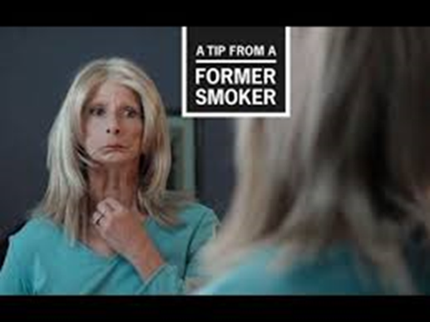
Tobacco
Establish tobacco-free campaigns
Tips from former smokers (Centers for Disease Control and Prevention, 2014; National Cancer Institute, 2008; Durkin S, 2012; Farrelly MC, 2012)
What are available services and resources for tobacco cessation; coverage for tobacco cessation treatment (counseling and medication)
Our worksite's tobacco-free policy is: …
The consequences of policy non-compliance
How the policy is enforced
How to report violations

Slide 31
Well-Being

Slide 32
Programs

Slide 33
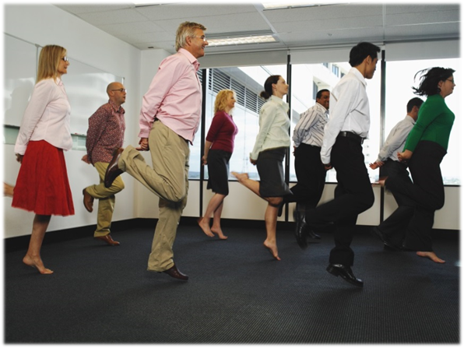
Physical Activity
Employee challenges, competitions (Racette et al., 2009; Wilson et al., 2010)
Team sports, recreation league (Brinkley, McDermott, & Munir, 2017)
Employee activity club (walking, running) (Gilson et al., 2009)
Regular exercise classes (Jakobsen et al., 2015; Racette et al., 2009)
Sedentary reduction program to plan when, where & how to sit less at work (Wong & Prapavessis, 2015)
Offer at least one organized 10–15-minute physical activity break each workday (Yancey et al., 2004; Taylor et al., 2014)

Slide 34
Food and Beverage
5-a-Day nutritional program
Counseling or behavioral interventions to improve dietary intake; tailored feedback on diet and clinical values (from dietician)
Host or promote:
Farmer's market
Community supported agriculture
Other programs:
Healthy cooking classes
Healthy lunchbox challenge

Slide 35
Tobacco
Medication and counseling programs
Kansas Tobacco Quitline
Web-based
Phone-based
Partners in Quitting: Smokeless Tobacco Cessation Program

Slide 36
Well-Being
Relaxation programs (meditation, mindfulness, yoga, tai chi, onsite physical activity classes, arts activities)
Professionalism skills (problem-solving, time-management, job skills training, resilience training, conflict resolution training, personal financial planning)
Emotional intelligence training (biofeedback, cognitive-behavioral skills, positive psychology, interpersonal skills training, assertiveness training, positive self-talk, viewing change and adaptation as positive)
Stress management program (cognitive behavioral based stress management, nature-based stress management, mindfulness-based therapy, stress support group)

Slide 37
Benefit Design

Slide 38
Physical Activity
Discount or subsidize memberships to local health clubs (Lin et al., 2014; Lucove, Huston, Evenson, 2007)
Premium reduction or deposit in HSA for maintaining or reaching a certain level of physical activity (Bicycle Commuter Act)
Reimburse employees for active commuting (walking, running, bicycling to/from work) (U.S. Bicycle Commuter Act)

Slide 39
Food and Beverage
Reward employees for “5 A Day” program participation by contributing funds in FSA/HSA
Free or low-cost consultation with dietician

Slide 40
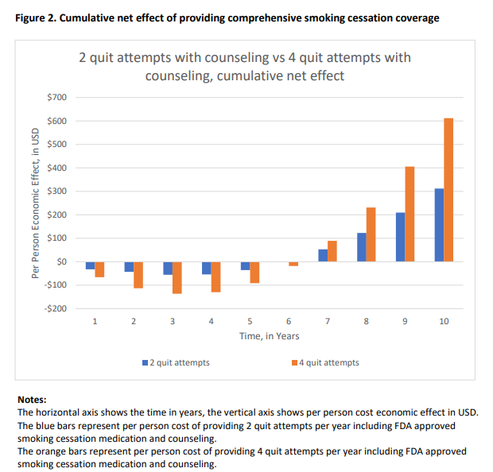
Tobacco
Coverage for tobacco cessation
counseling and medication

Slide 41
Well-Being
Employee Assistance Program (EAP)
Mental health screening
Access to mental health provider/treatment
Separate sick leave from vacation leave
Mental health leave
Childcare on site
Infants up to 6 months brought to work
Meaningful, and at least annual, employee recognitions
Internal promotions
Financial rewards (bonuses, raises)

Slide 42
Policy

Slide 43
Physical Activity
Provide a set time for physical activity during work hours (Taylor et al., 2014)
Flex-time for employees to engage in physical activity (Bale et al., 2015; Gryzwacs, Casey & Jones, 2007)
Allow employees to be physically active while ‘on the clock’(Gazmararian et al., 2013; Lucove, Huston & Evenson, 2007)
Allow for (and encourage) walking meetings (Kling et al., 2016)

Slide 44
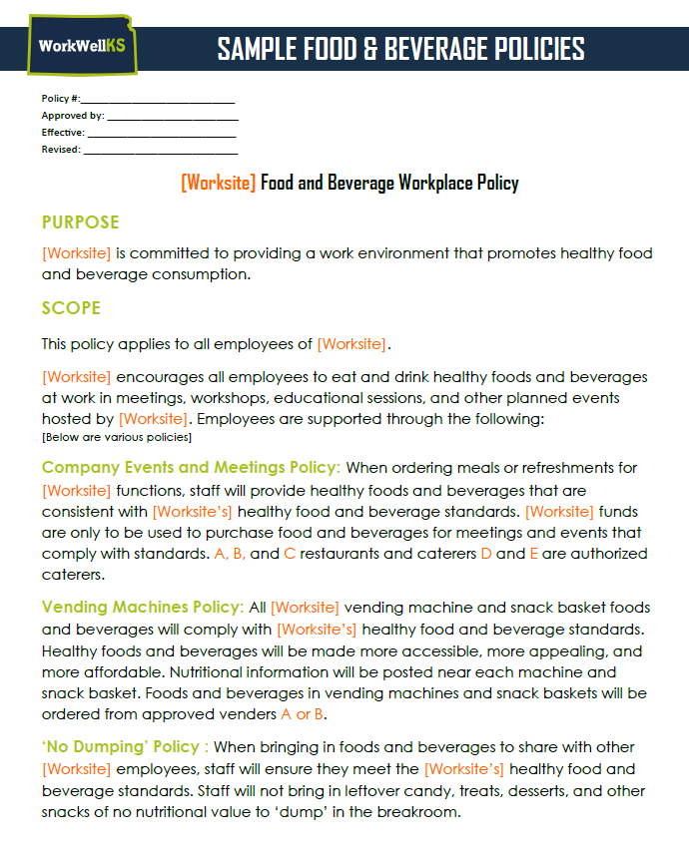
Food and Beverage
Adopt standards that define "healthy" foods and beverages
Adopt a policy that governs the offering of foods and beverages at your facility and where it applies (cafeteria, vending, potlucks)
‘No Dumping’ policy (staff will not bring in leftover candy, treats, desserts, and other snacks of no nutritional value to ‘dump’ in the breakroom)

Slide 45
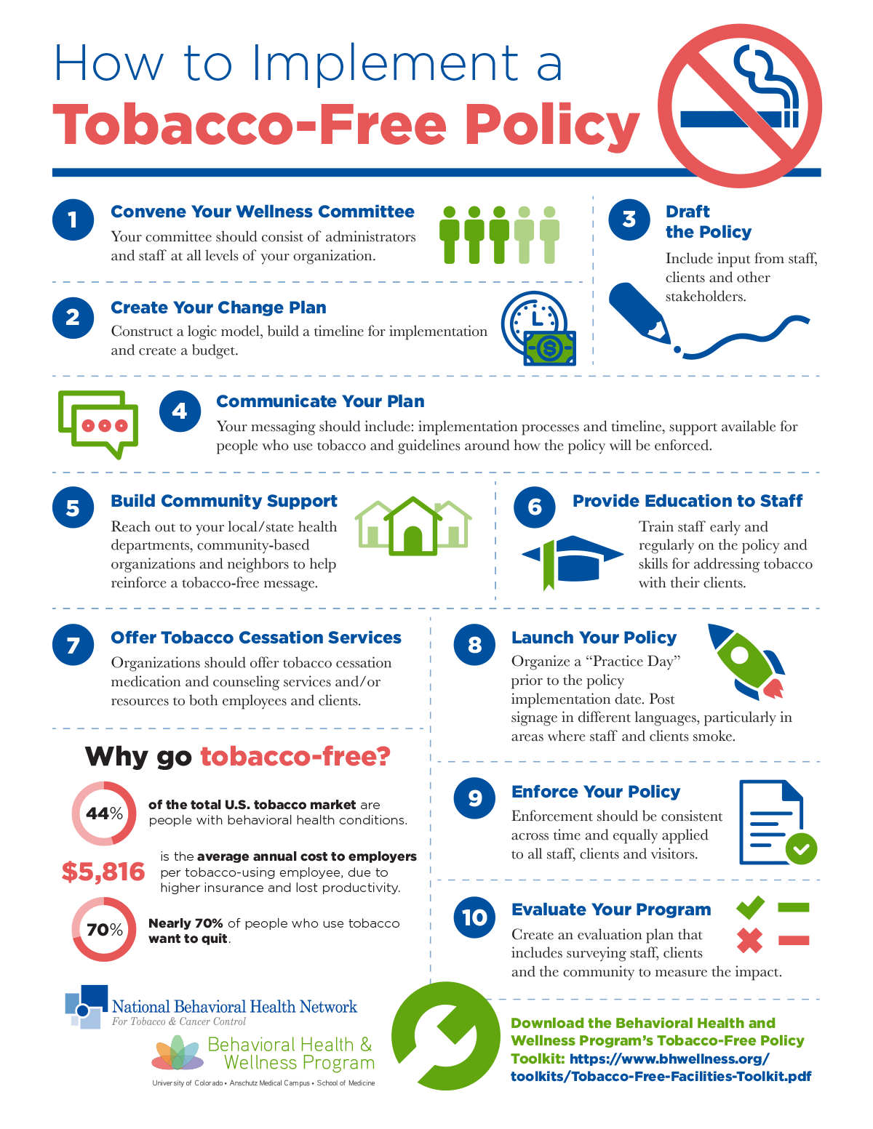
Tobacco
Adopt a tobacco-free policy that includes:
Cigarettes
Pipes
Cigars
E-cigs
Smokeless tobacco
Where/When (grounds, work vehicles, during work hours, in company uniform)

Slide 46
Well-Being
Employees can take two 10–15-minute rest/booster breaks each day
Time/accommodations for mental health/stress management
Preventing /addressing sexual harassment
Preventing /addressing bullying
Gradual retirement
Flex-time
Stable shifts
Teleworking
Notes:
Optometric Billing Solutions
Flex work schedules (5 am – 8 pm), Monday – Saturday
Some can work remotely

Slide 47
Environment

Slide 48
Physical Activity
Centralize amenities (e.g., printers, trash cans, supplies, mail)
Space for group or individual exercise (not a fitness facility)
Enhance walkways and stairwells (e.g., keep areas clean, add artwork)
Standing height tables and chairs in meeting rooms and break rooms
Fitness facility (with updated, clean, useful equipment)
Showers, changing facilities, and lockable storage
Create a walking trail, post mile markers
Install secure bicycle rack or bike storage
Install a basketball hoop
Safe outdoor activity feature (attractive green space)
Point of decision prompts (e.g., use the stairs, stretch while you heat your lunch)
Height-adjustable desks or active workstations (treadmill or cycle desks)

Slide 49
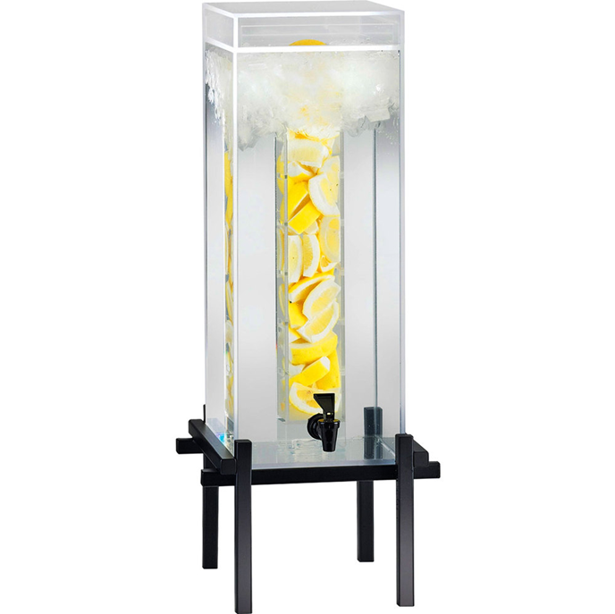
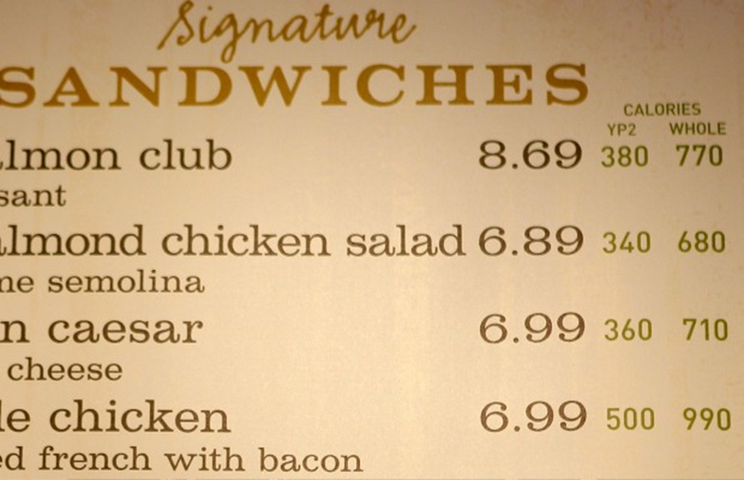
Food and Beverage
Make fruits, vegetables, and other healthy foods and beverages available
Provide safe, unflavored, cool drinking water at no cost
Decrease availability of sugar-sweetened beverages
Point of purchase
Menu labeling
Offer on-site purchase of fruits and vegetables (e.g., farmer's market, CSA)
Healthy dinners to go
Provide healthy snacks (especially fruits and veggies) in breakroom
Increase access to and variety of healthy foods
Provide healthy vending

Slide 50
Tobacco
Post signs that state that smoking is prohibited by state law and display the international "no smoking" symbol.
Re-purpose areas that were designated as tobacco areas for other uses (e.g., tobacco shack converted to bike shelter, smoking gazebo converted to garden)!

Slide 51
Well-Being – Physical Environment
“Zen,” comfort, relaxation room
Nature outside; Garden (can step away from work environment)
Give employees access to sunlight, natural light, windows, nature inside (e.g. plants)
Offer personal, private spaces
Seating arrangements to facilitate collaboration among employees
Adequate ventilation; non-florescent, adequate lighting; adequate office cleaning
Tobacco and smoke-free
Allow employees to listen to their choice of music & personalize their workspace

Slide 52
Well-Being – Social Environment
Uninterrupted meal breaks for employees
Worksite offers at least annual social events
Worksite offers sports team for employees
Employees have meaningful and/or stimulating work; are offered career development opportunities
Employees have some control in decision-making that affects their jobs
Match the demands of the work (e.g., workload, pace) to employees’ abilities
Worksite fosters social support among colleagues
Managers are willing to redesign work to improve fit or decrease stress
Employees are encouraged to volunteer in the community

Slide 53
Take Action in the Community

Slide 54
Physical Activity

Slide 55
Physical Activity
Fund and support physical activity campaigns
Join and support a health coalition
Fund and support community beautification efforts: allow employees paid time to volunteer (Maryland Institute College of Art)
Sponsor bikeshare or other active transportation programs (Green Apple Bikes)
Support community physical activity initiatives financially or by providing space for programs (HIP-Cuyahoga)
Help create active transportation plans or bicycle/pedestrian plans to guide governments in developing transportation networks that accommodate all forms of transportation

Slide 56
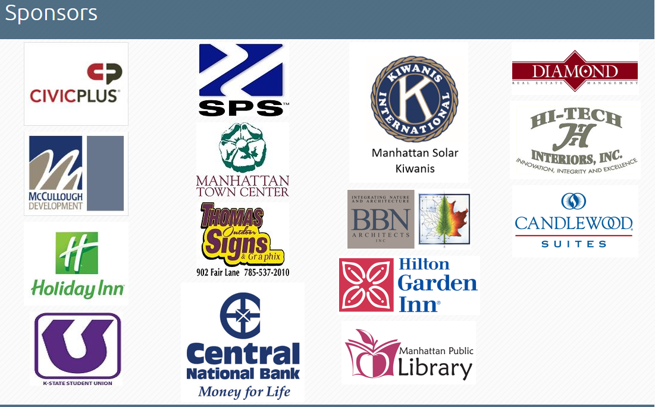
Launched in Manhattan, Kansas in September 2015.
Today, Green Apple Bikes has purchased 900 bikes and has 400-500 on the streets at any given point.
Funded by 18 different corporate sponsors, as well as individual donations, the system is completely organized by volunteers.
Essential Bikes initiative matches donated, refurbished bicycles with folks in need, providing a helmet, light and credit for ongoing bike maintenance at a local shop.

Slide 57
Food and Beverage

Slide 58
Food and Beverage
Fund and support healthy foods and beverage campaigns
Join and support a health coalition/food policy council
Purchase locally produced foods (Cactus Cares)
Support community kitchens, mobile markets, and food-to-institution programs
Open your worksite space for food education programs (HIP-Cuyahoga)
Fund and support community farms (Stamford Hospital)

Slide 59
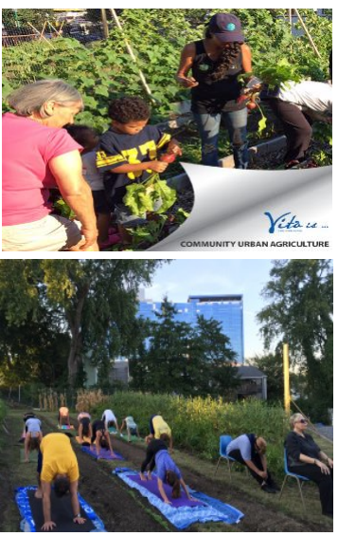
Stamford Health has numerous initiatives and partnerships in the community to improve health in Fairfield County, Connecticut.
To address food insecurity in 2011, developed an acre organic farm – Fairgate Farm.
Results:
700 volunteers/year
Provide free produce to patients
Sponsor farm to table dinners in neighborhood
Harvested 2 tons of produce, 1,000 lbs of veg to a local food pantry in 2017.

Slide 60
Tobacco

Slide 61
Tobacco
Join and support a health/tobacco coalition (Tobacco 21 KC)
Help to develop a tobacco prevention program for K-12 students with local experts (health department, lung association) (Cleveland Clinic)
Pay for nicotine replacement therapy for local residents (Cleveland Clinic)
Implement a nicotine-free hiring policy. Offer job candidates who use nicotine a free cessation assistance program and encourage them to reapply in 90 days (Cleveland Clinic, U-HAUL)

Slide 62
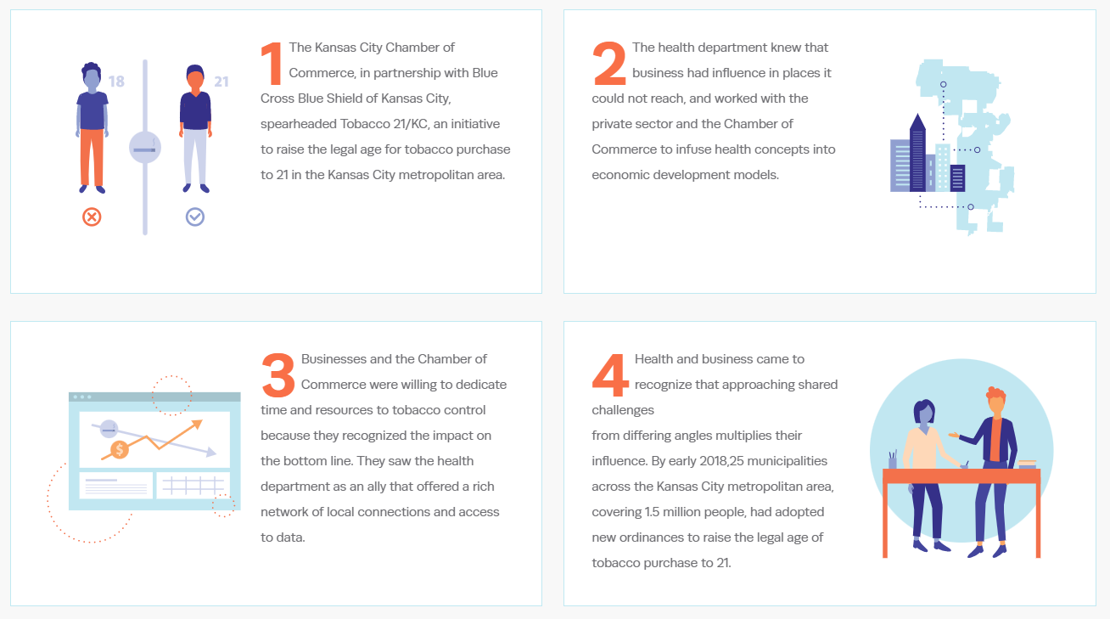
Notes:
KC Tobacco 21 was passed in 25 municipalities with the help of local businesses

Slide 63
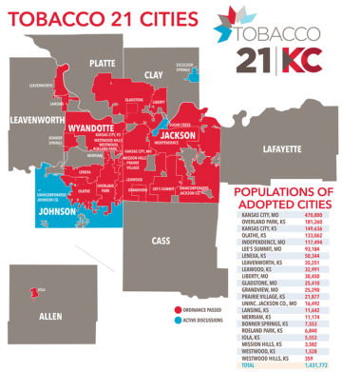
Notes:
KC Tobacco 21 was passed in 25 municipalities with the help of local businesses

Slide 64
Well-Being

Slide 65
Well-Being
Fund and support healthy well-being campaigns (Resilient KC)
Provide an Employer Assisted Housing (EAH) program (qualified employees’ get funds for down payment and closing costs as a loan that is forgiven over a period of time, as long as the recipient stays with the employer)
Support affordable housing development, home repairs and beautification efforts (Children’s Museum of Indianapolis, Maryland Institute College of Art)
Contribute to local workforce development efforts by providing or supporting worker training and education (Case Western Reserve University, Cleveland Clinic, Capital One, Los Angeles County Museum of Art)

Slide 66
Childcare Availability and Affordability
Employers who provide child care facilities and equipment get credit, but it is capped at $45,000 for the initial year and $30,000 for subsequent years.
The credit for employers paying for employees’ child care, meanwhile, is capped at $30,000 for any taxable year.
Child daycare assistant tax credit program incentivizes worksites to:
Cover a portion of employees’ child care costs
Provide onsite child care

Slide 68
Questions?

Slide 69
WorkWell KS Contacts
Elizabeth Ablah, PhD, MPH
Allison Honn, MBA
Melinda Chenault, MPH
Faith Plummer
Research Manager
ahonn@kumc.edu
Research Assistant
fplummer@kumc.edu
Professor eablah@kumc.edu
Research Associate
mchenault@kumc.edu
www.workwellks.com
workwellks@kumc.edu

